Slide 1


Week 2
1

Slide 2
Index
2
Sr no | index
1 | Week2Sketch1
2 | Week2Sketch2
3 | Week2Sketch3
Sr. no
1
2
3
4
5
Contents
Week1Sketch1
Week1Sketch2 Week1Assignment1
Week1Assignment2 Insights

Slide 3
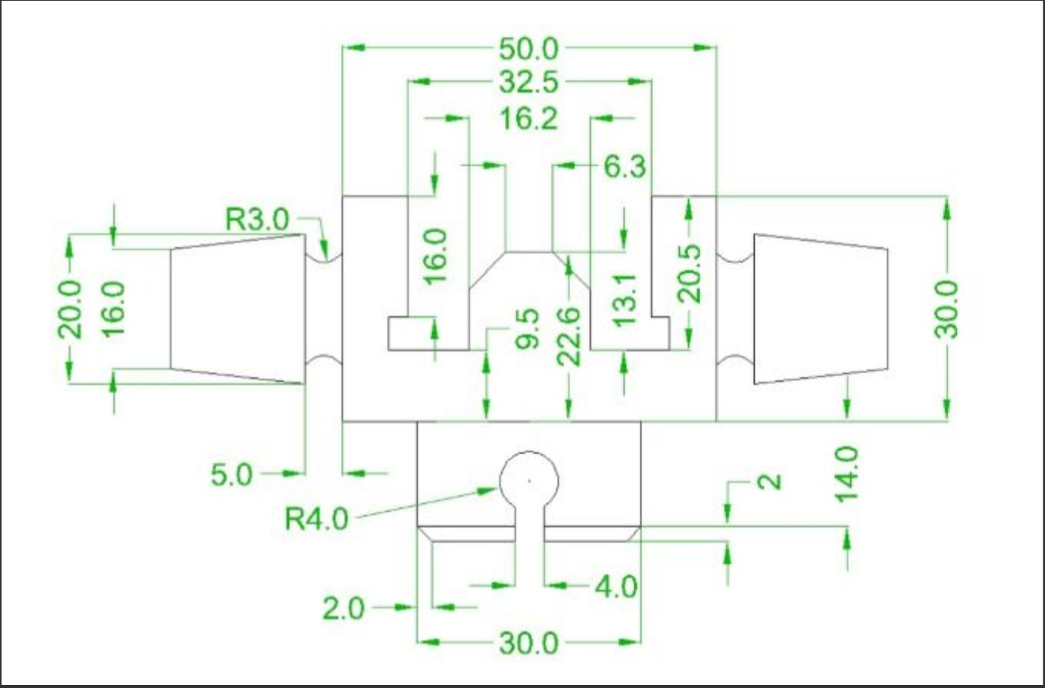
WeekSketch1
3

Slide 4
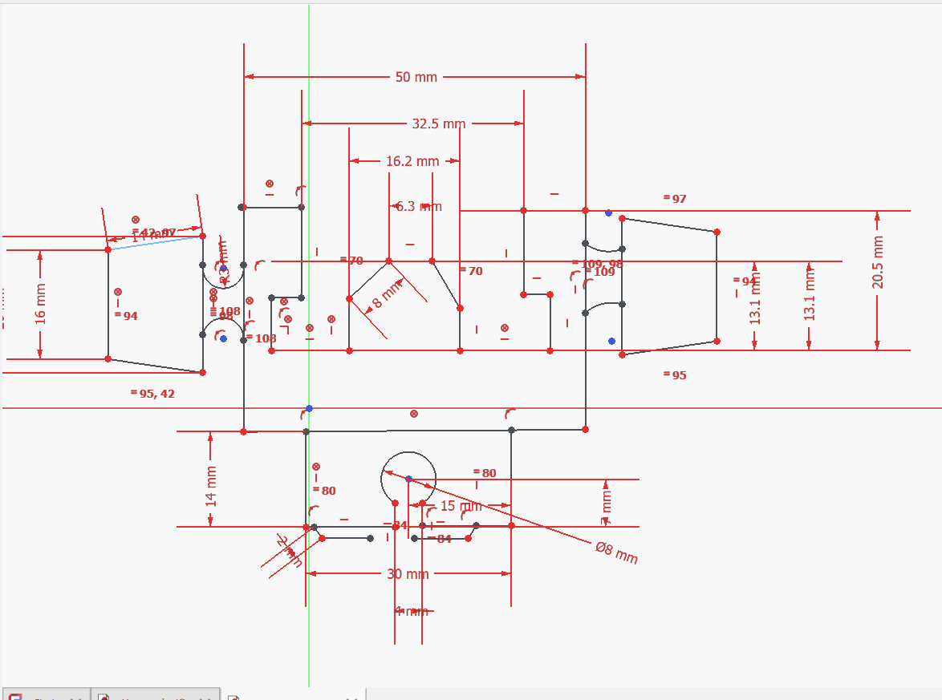
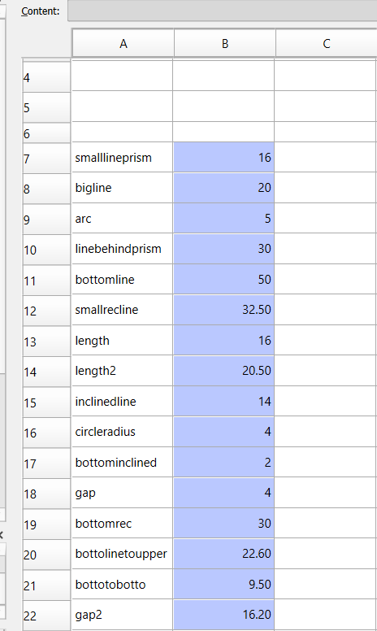

Slide 5
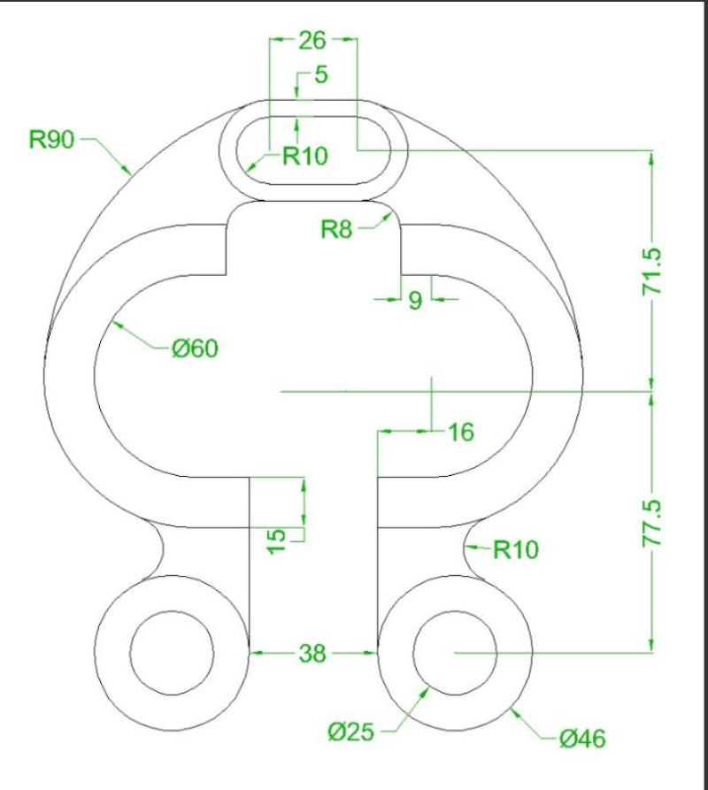
WeekSketch2

Slide 6
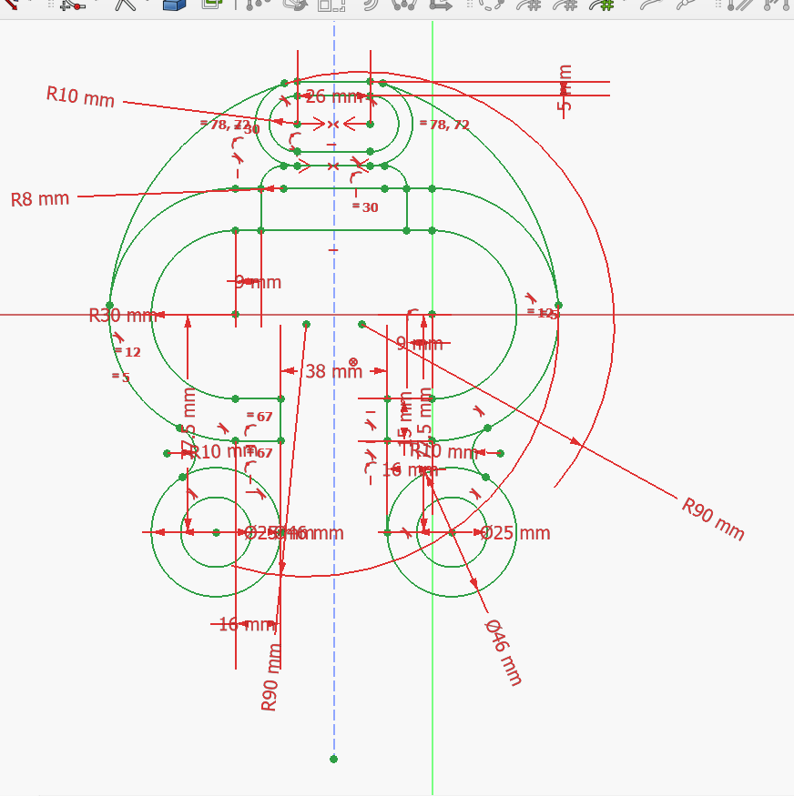

Slide 7
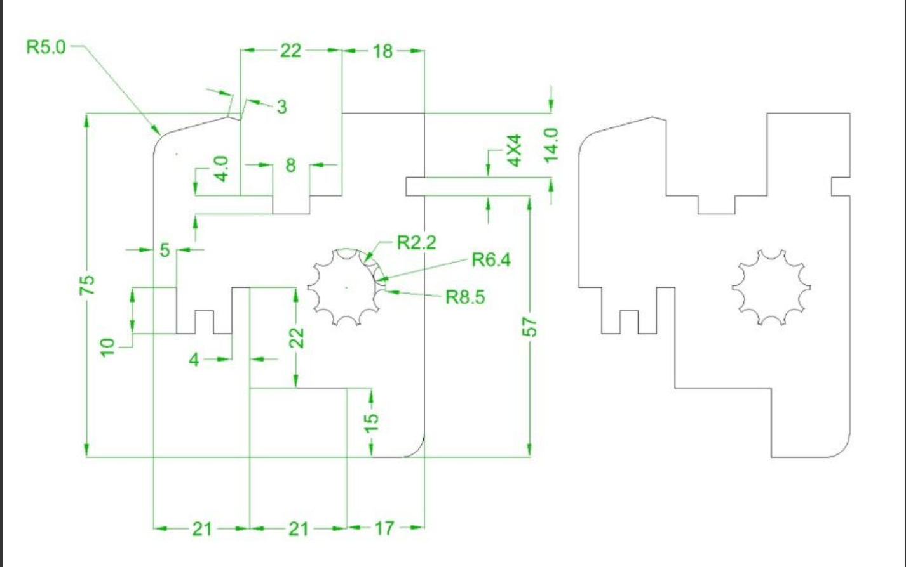
Week2sketch3

Slide 8
